Slide 1
Dance Battle
Amara gordon

Slide 2
Dance Genre History
Hip Hop Definition: Hip-hop dance refers to street dance styles primarily performed to hip-hop music or that have evolved as part of hip-hop culture. It includes a wide range of styles primarily breaking, locking, and popping which were created in the 1970s and made popular by dance crews in the United States.
Contemporary Definition: Contemporary dance is a genre of dance performance that developed during the mid twentieth century and has since grown to become one of the dominant genres for formally trained dancers throughout the world. Although originally informed by and borrowing from classical, modern, and jazz styles, it has since come to incorporate elements from many styles of dance.[1] Due to its technical similarities, it is often perceived to be closely related to modern dance, ballet, and other classical concert dance styles.

Slide 3
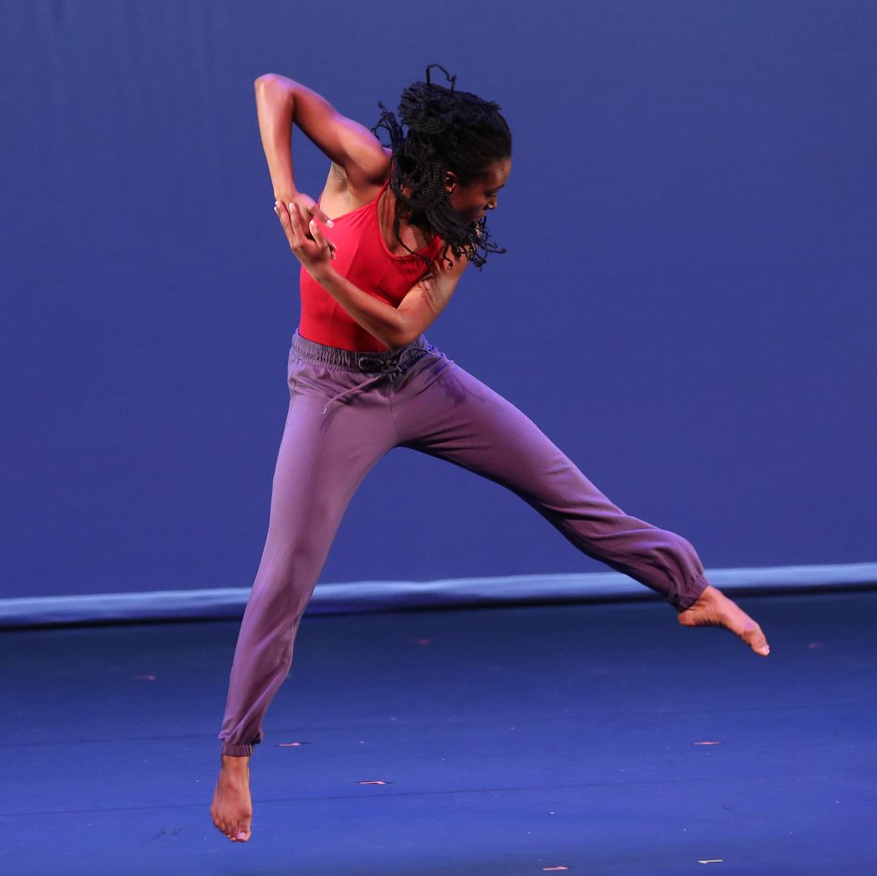
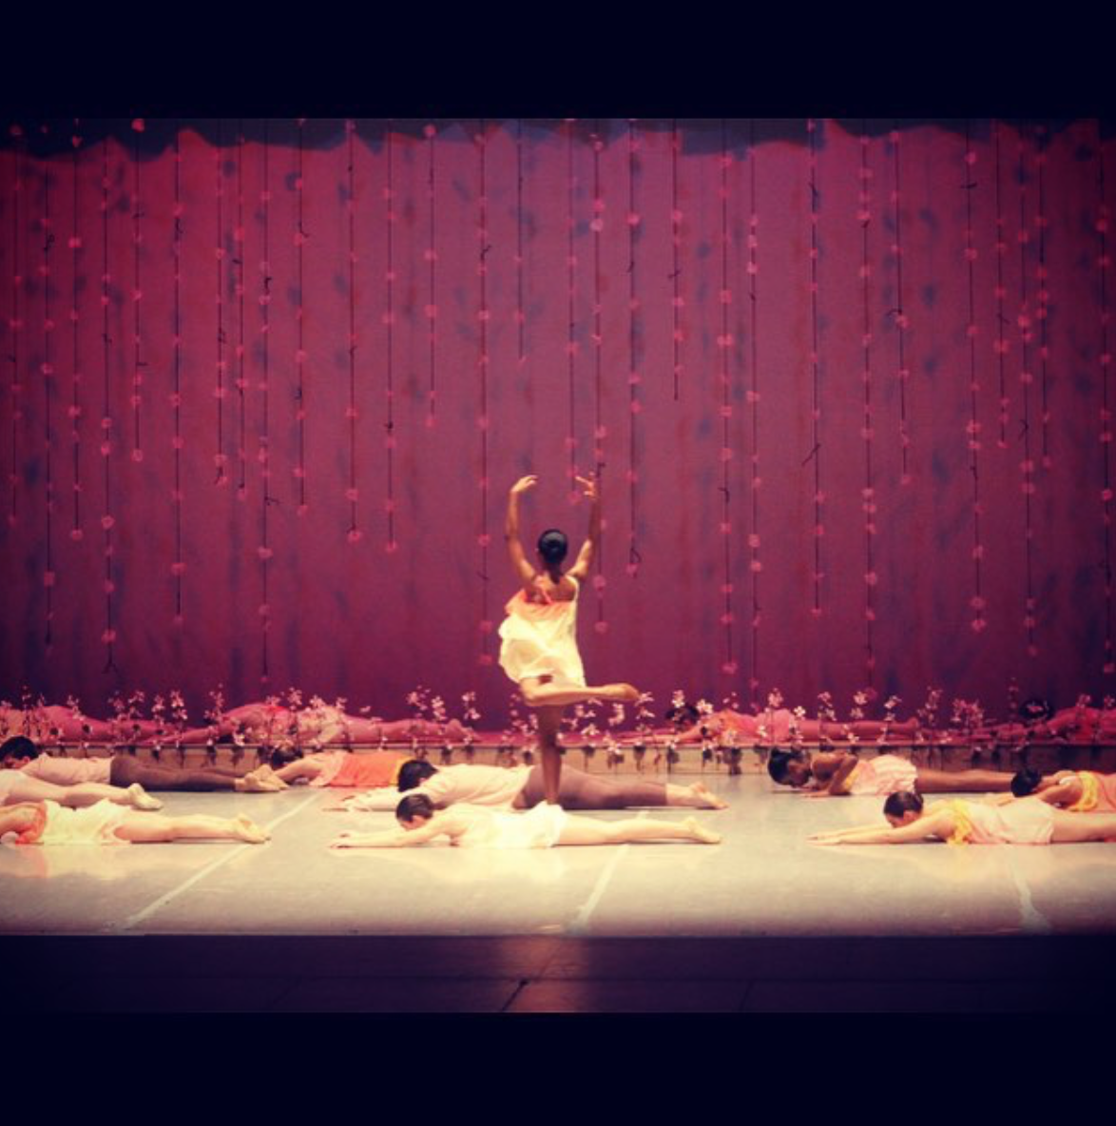
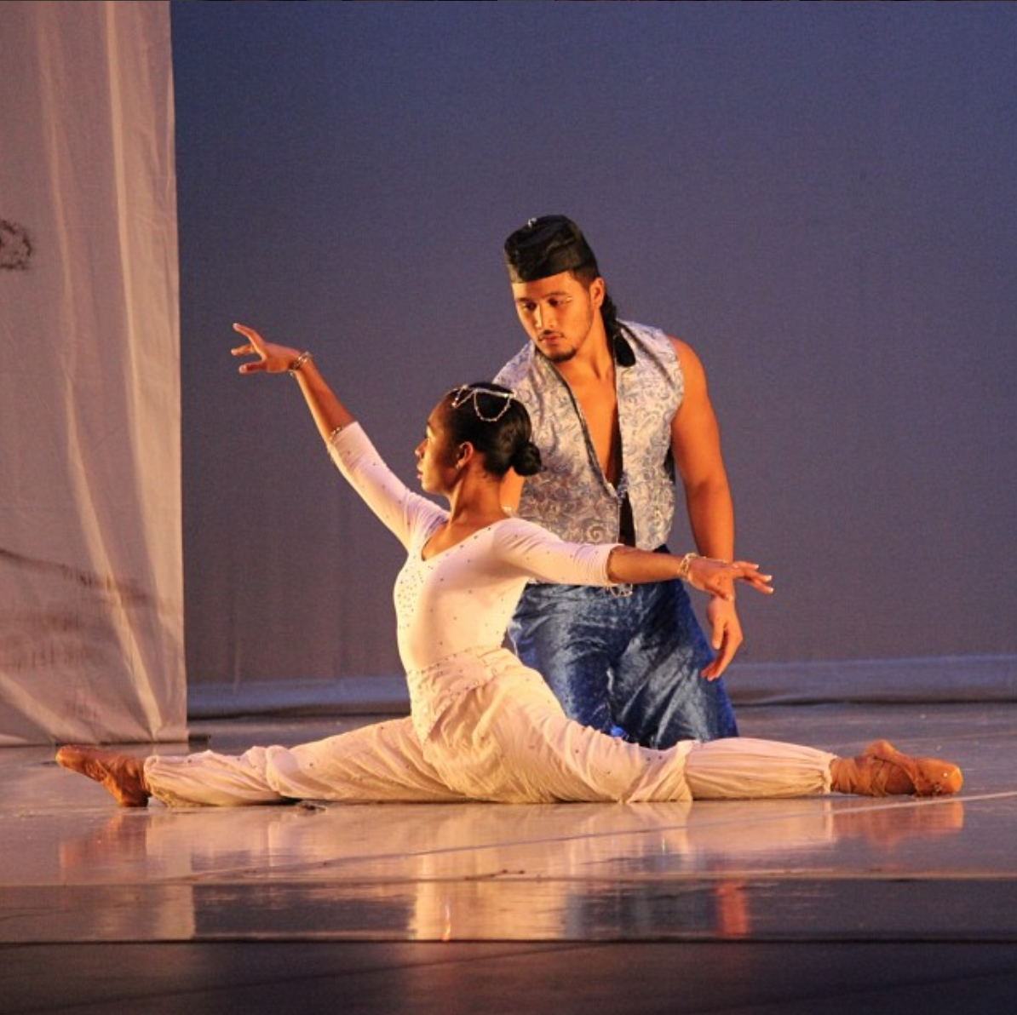
Why?

Slide 4
Hypothesis
Hip hop videos would have more negative comments and contemporary videos would have more positive comments

Slide 5
Video Sources
So You Think You Can Dance

Slide 6
Videos
Contemporary
Medicine: https://www.youtube.com/watch?v=RQ11mwgbReE
Amy & Travis: https://www.youtube.com/watch?v=khvcCpoFszM
Hallelujah: https://www.youtube.com/watch?v=G8u8xPLar-E
Hip Hop
My Chick Bad: https://www.youtube.com/watch?v=hATakt0zOzg
Outta Your Mind: https://www.youtube.com/watch?v=TLtSfYX8tJk
Hello Good Morning: https://www.youtube.com/watch?v=tCb_UOakEQI

Slide 7
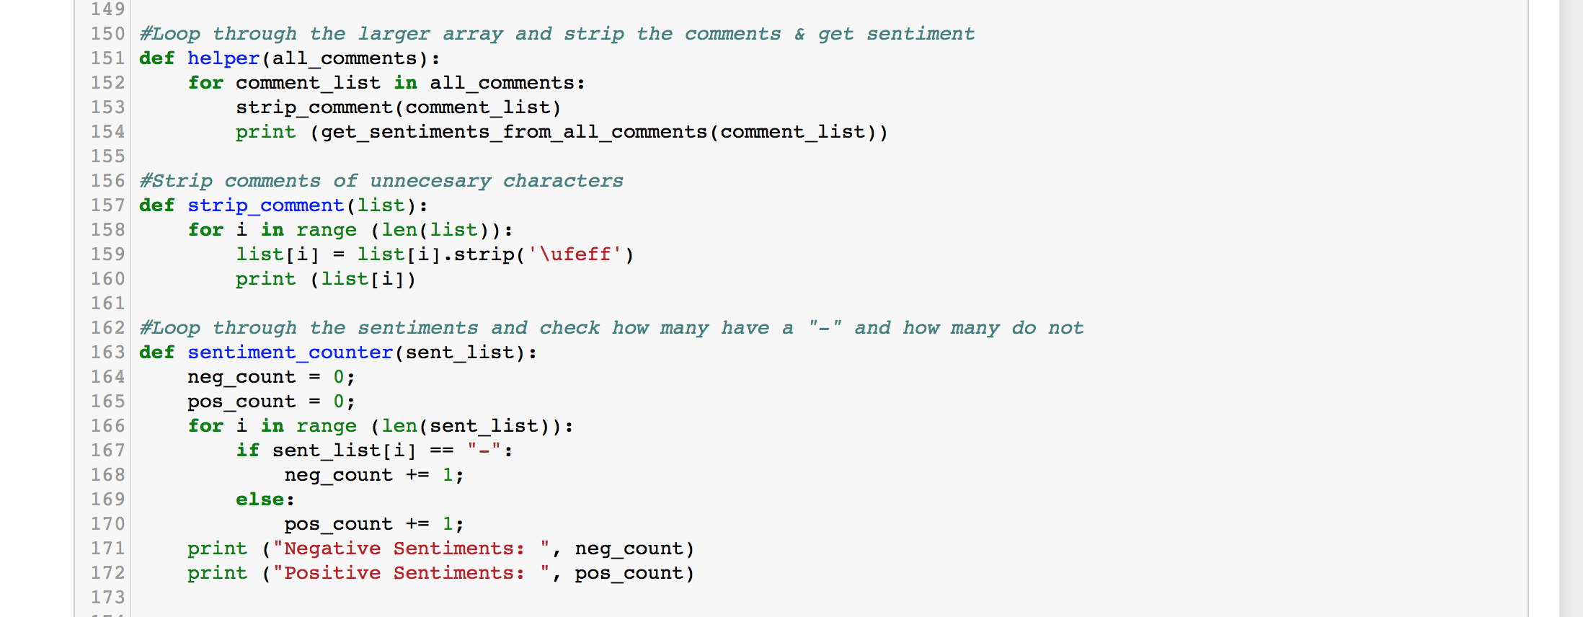
Functions

Slide 8
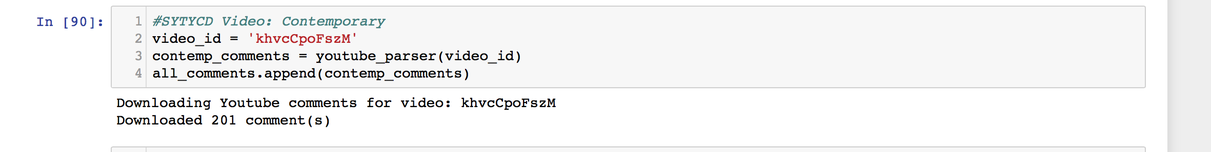
Gathering Comments

Slide 9
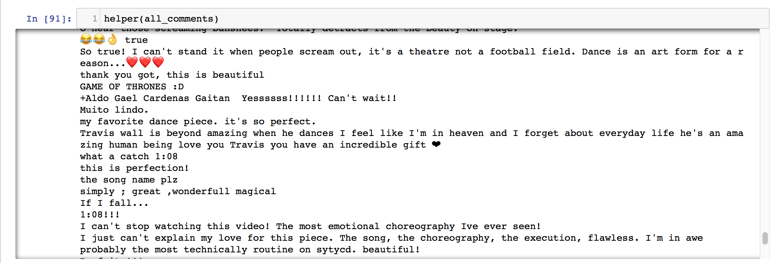
Gathering Comments

Slide 10
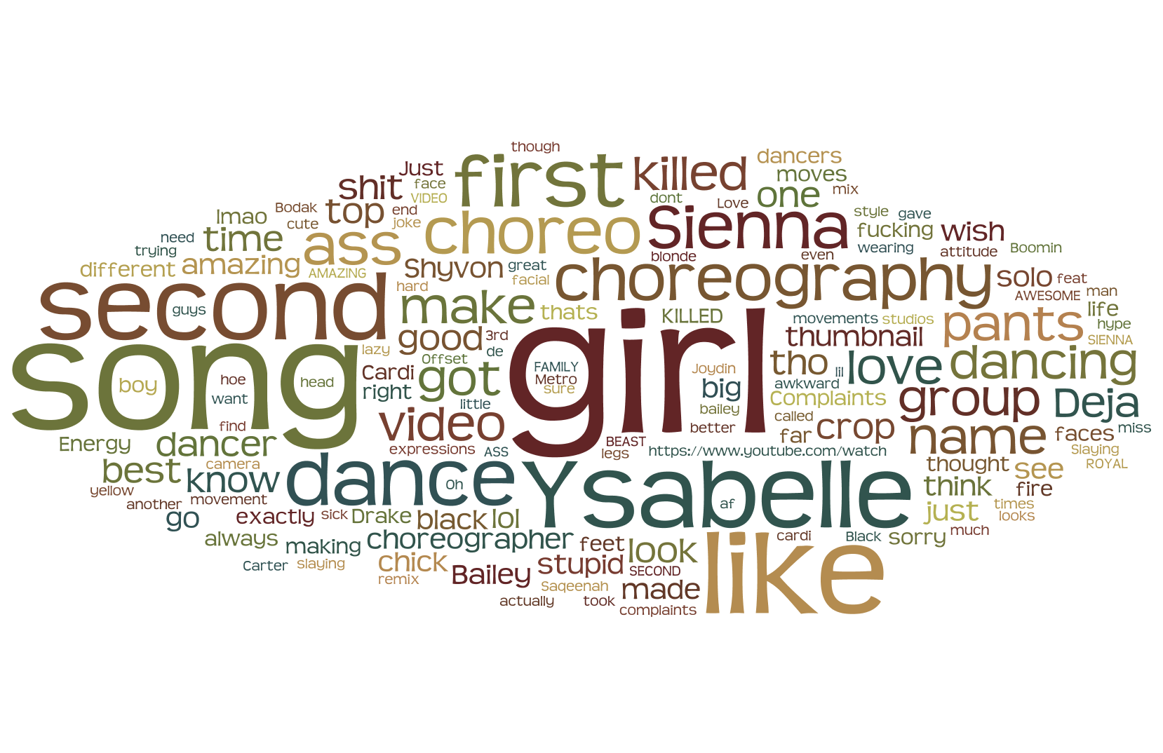
Hip Hop

Slide 11
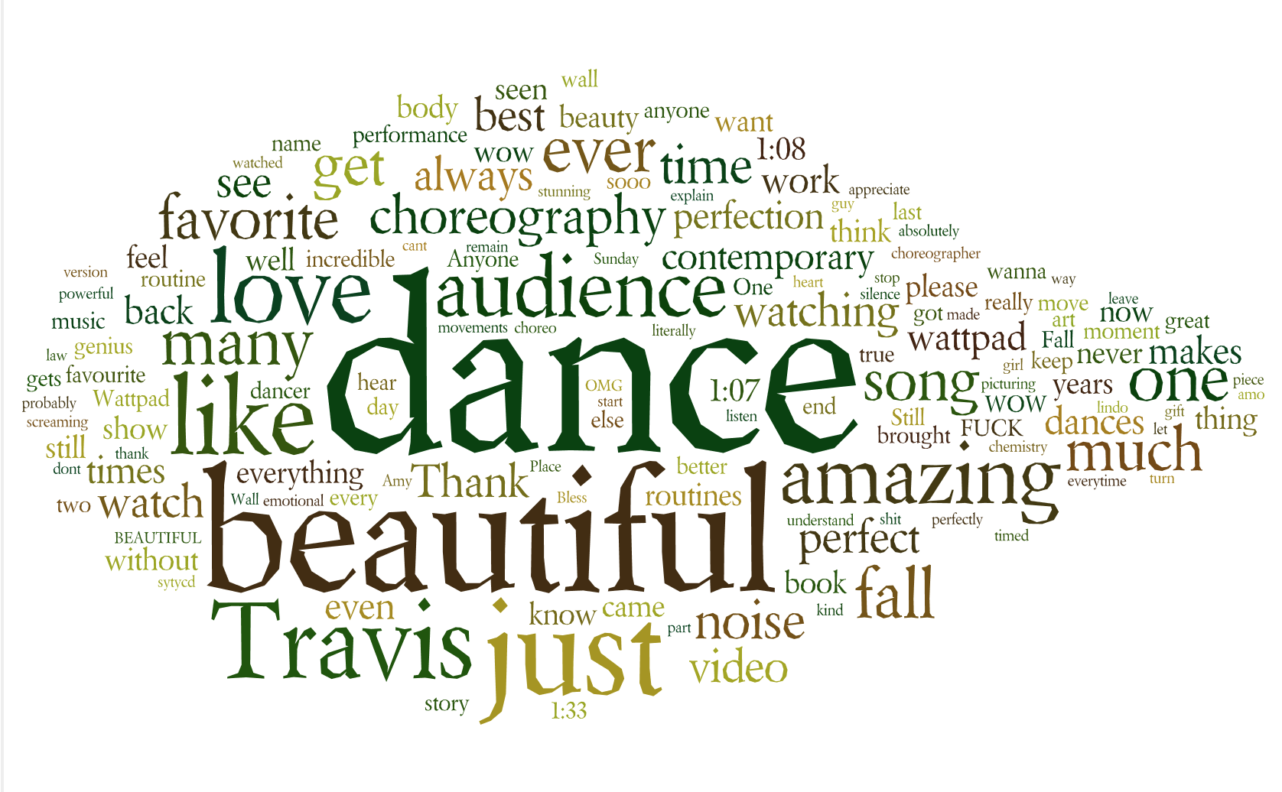
Contemporary

Slide 12
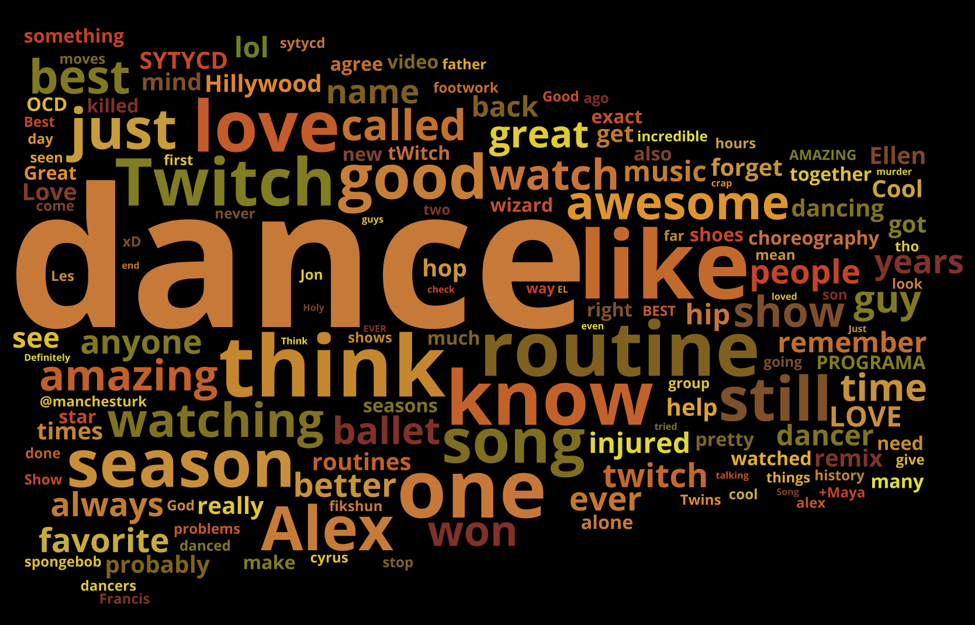
Hip Hop Videos

Slide 13
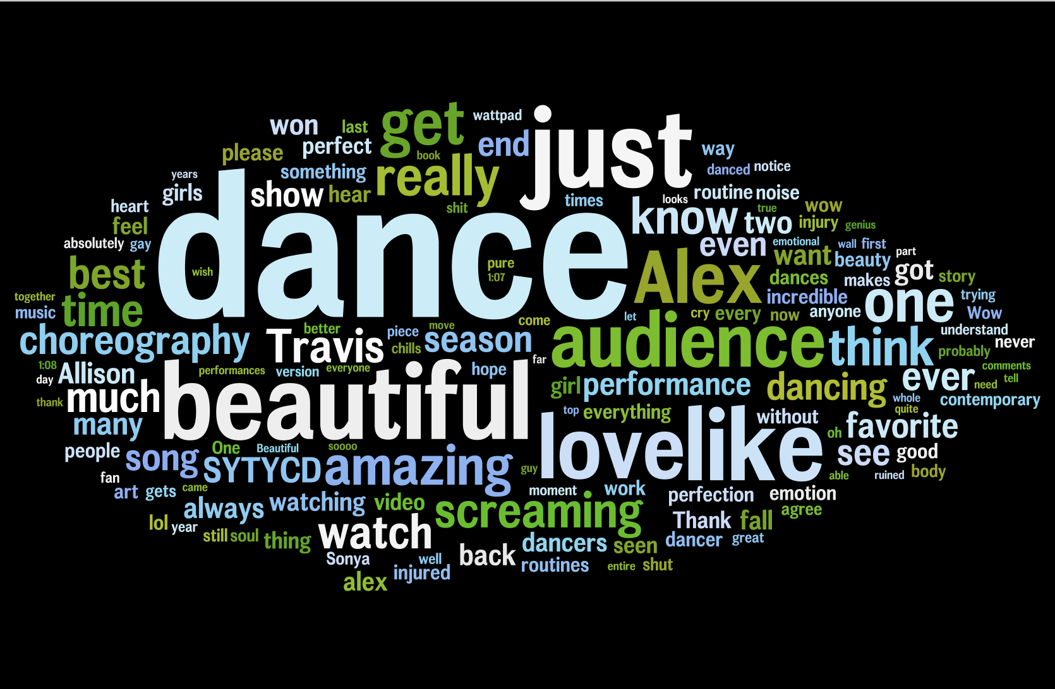
Contemporary Videos

Slide 14
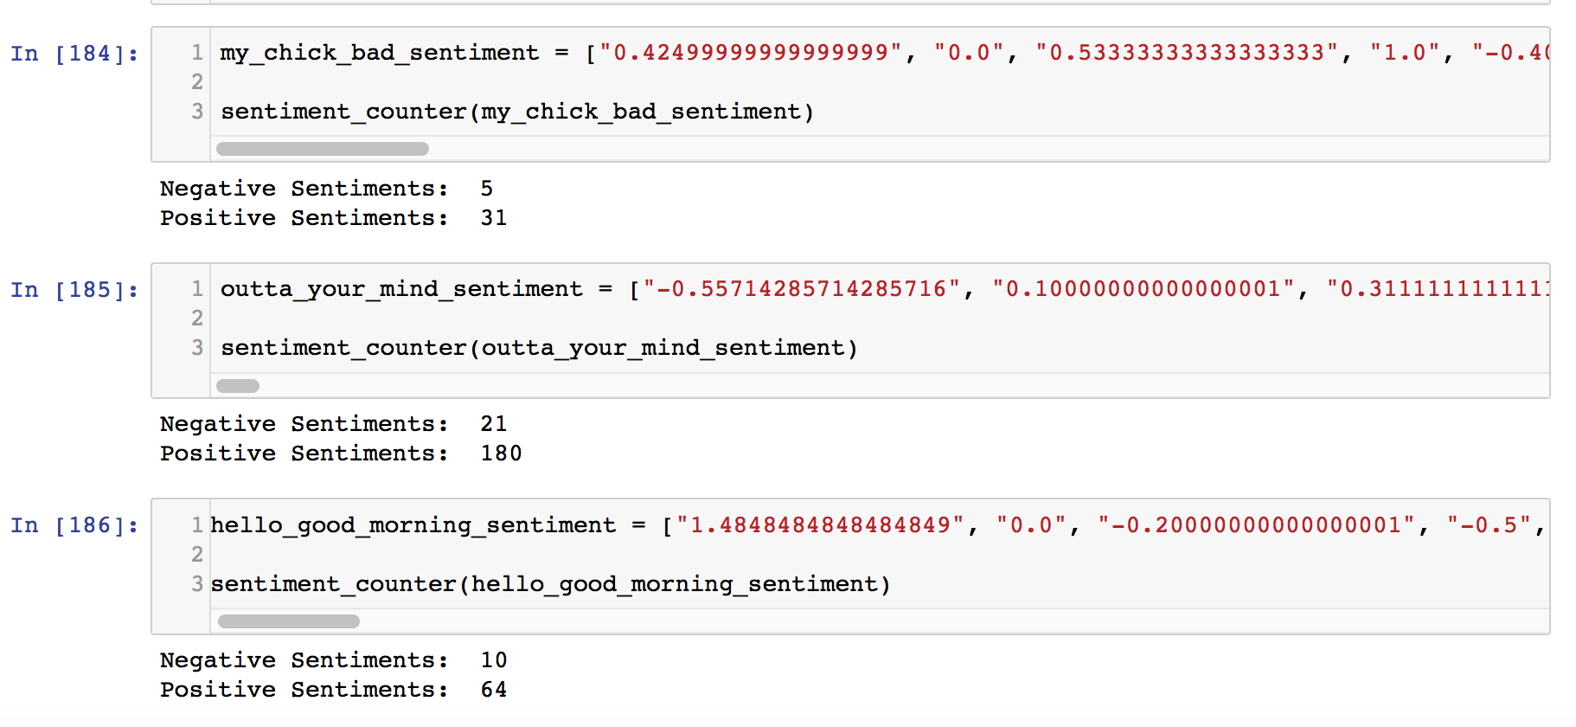

Slide 15
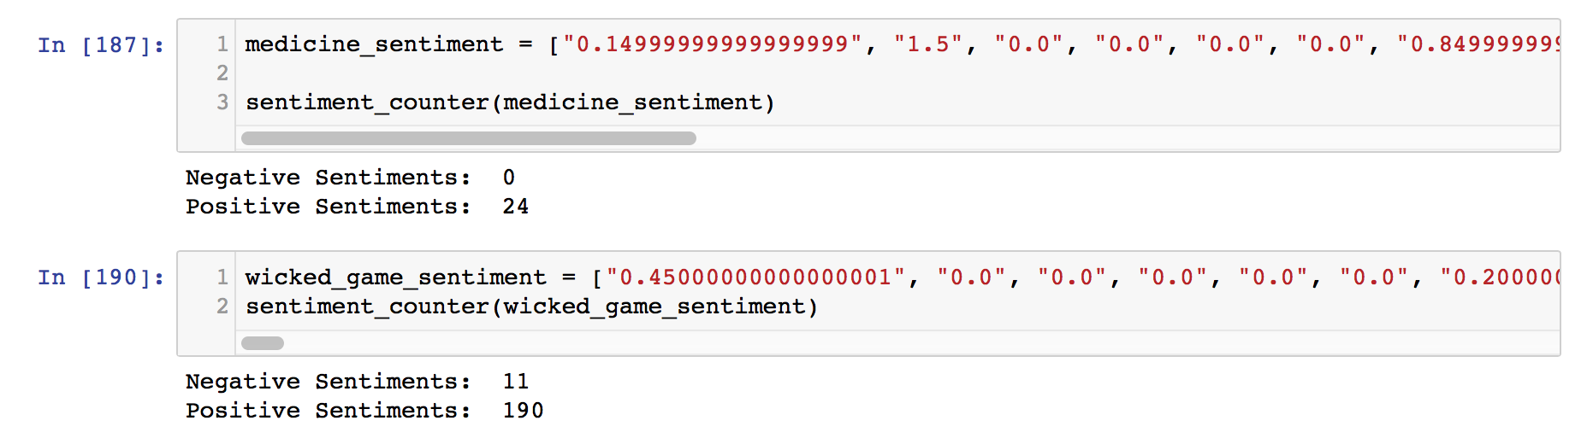

Slide 16
Interesting Findings
In the set of contemporary videos, there was one that had 100% positive comments
Not the same for the hip hop videos

Slide 17
Stretch Questions
Look into sentiment analysis and see how sentiment is determined
How do costumes influence comment sentiment
Compare sentiment of comments on YouTube to Instagram videos
Look into user profiles

Slide 18
Challenges
It proved to be difficult to find a ballet video with lots of comments
Cleaning the comments, and matching the sentiment
Sentiment score

